Slide 1
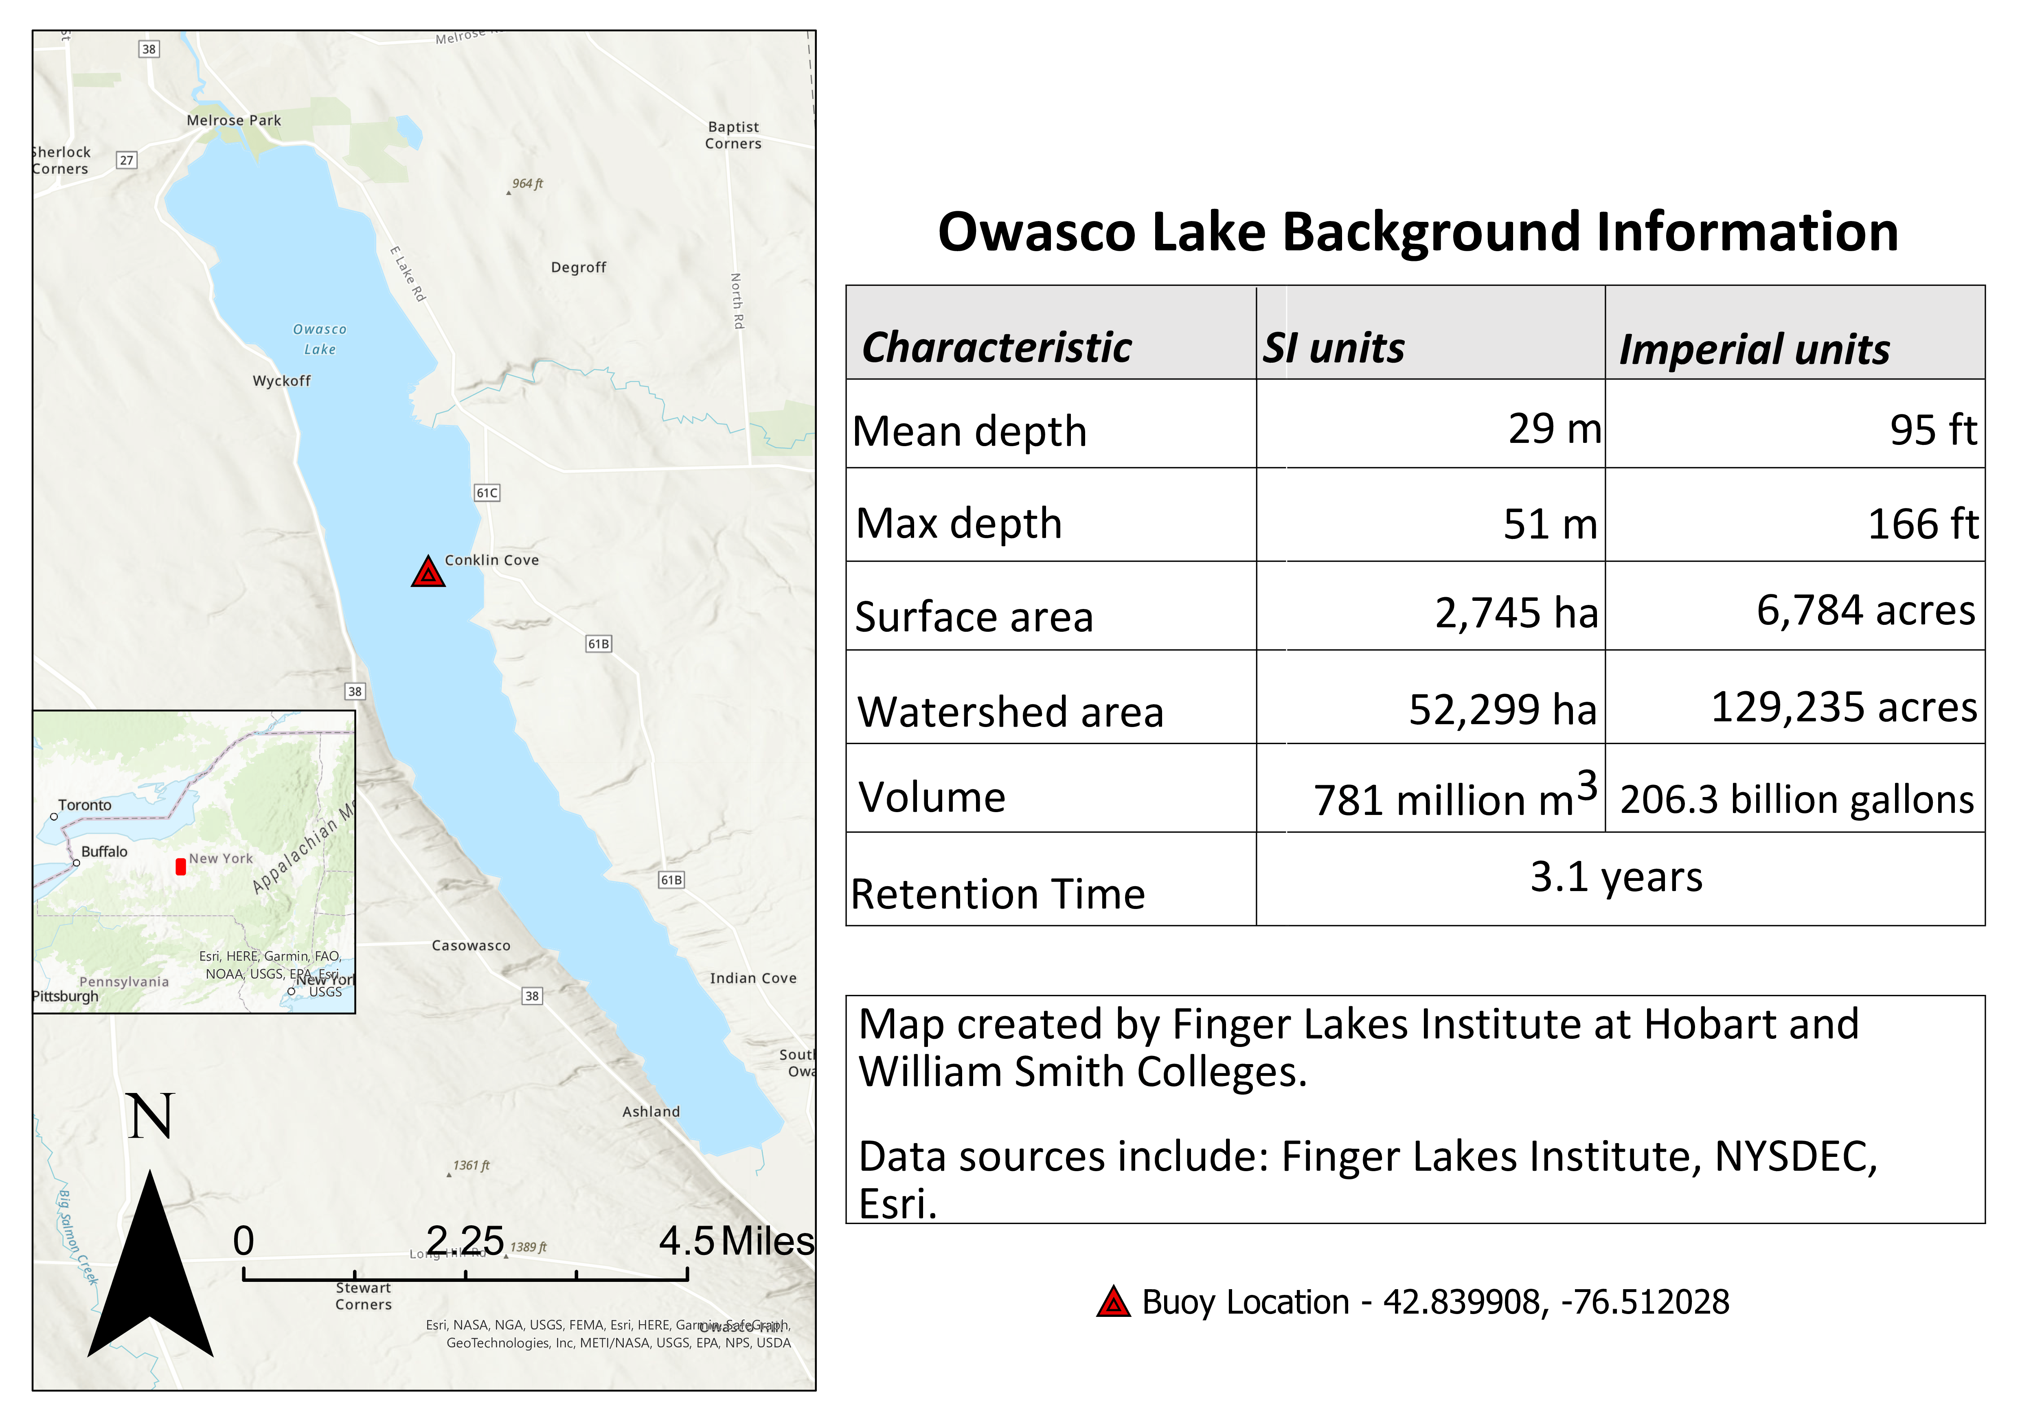
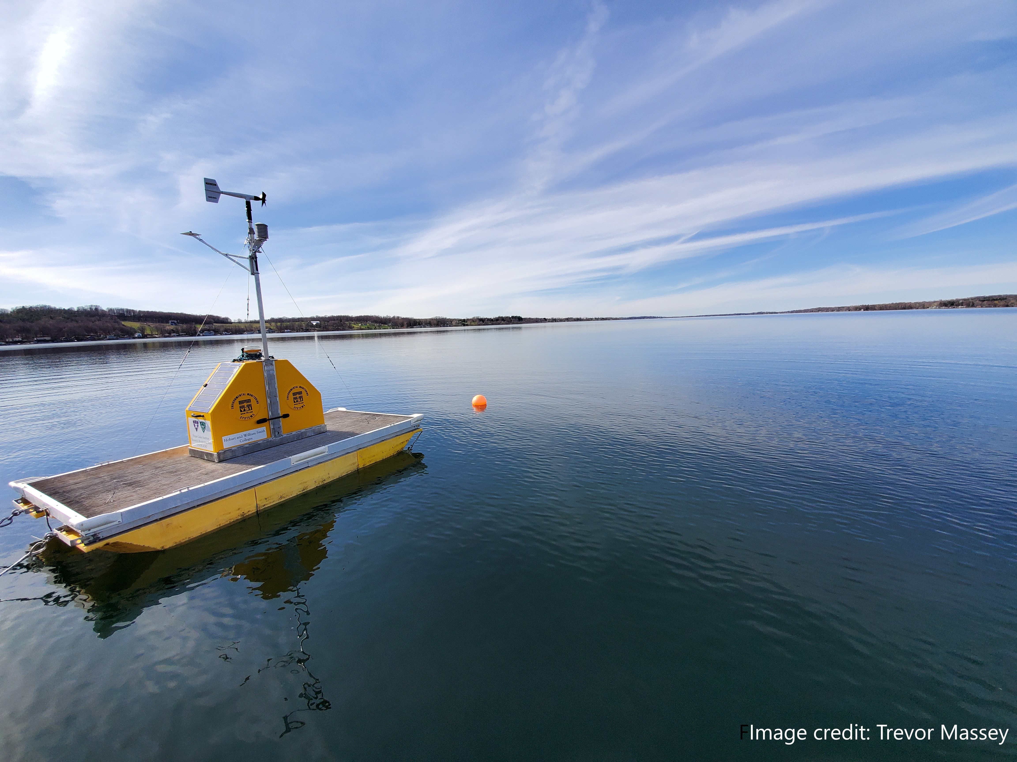

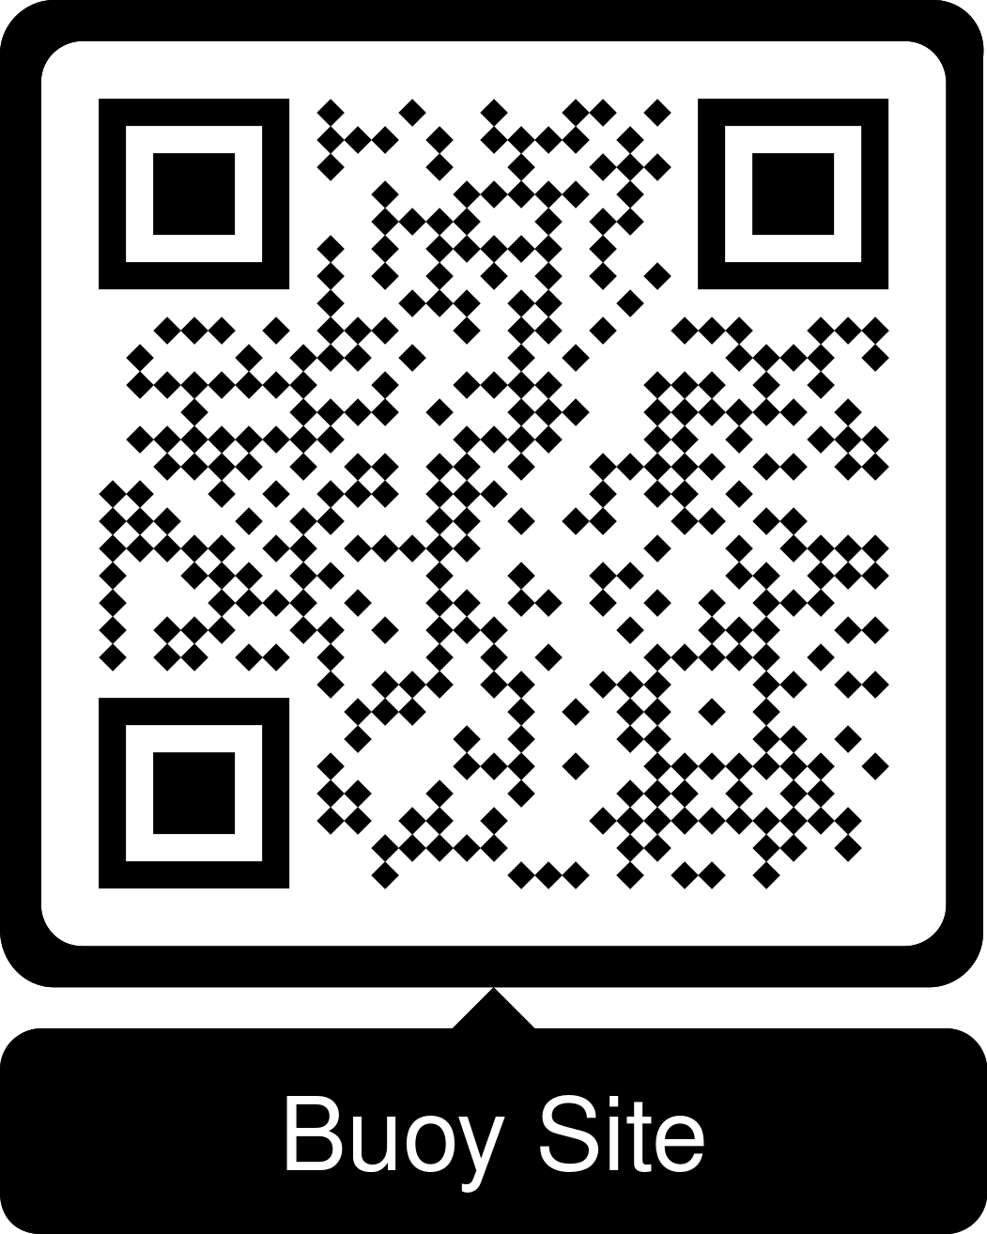




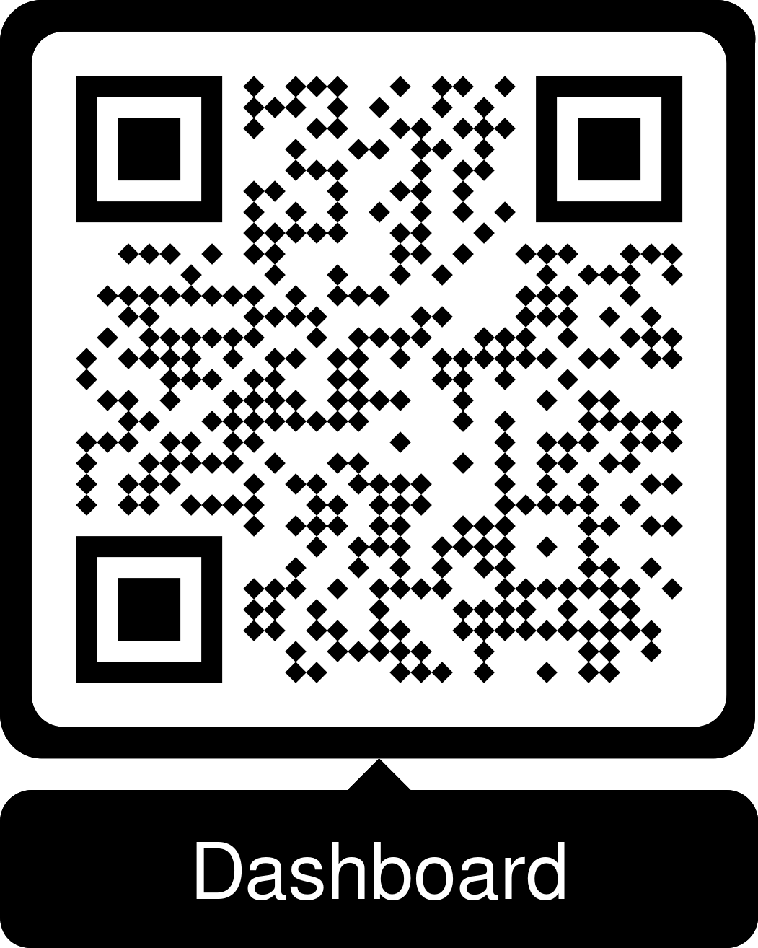
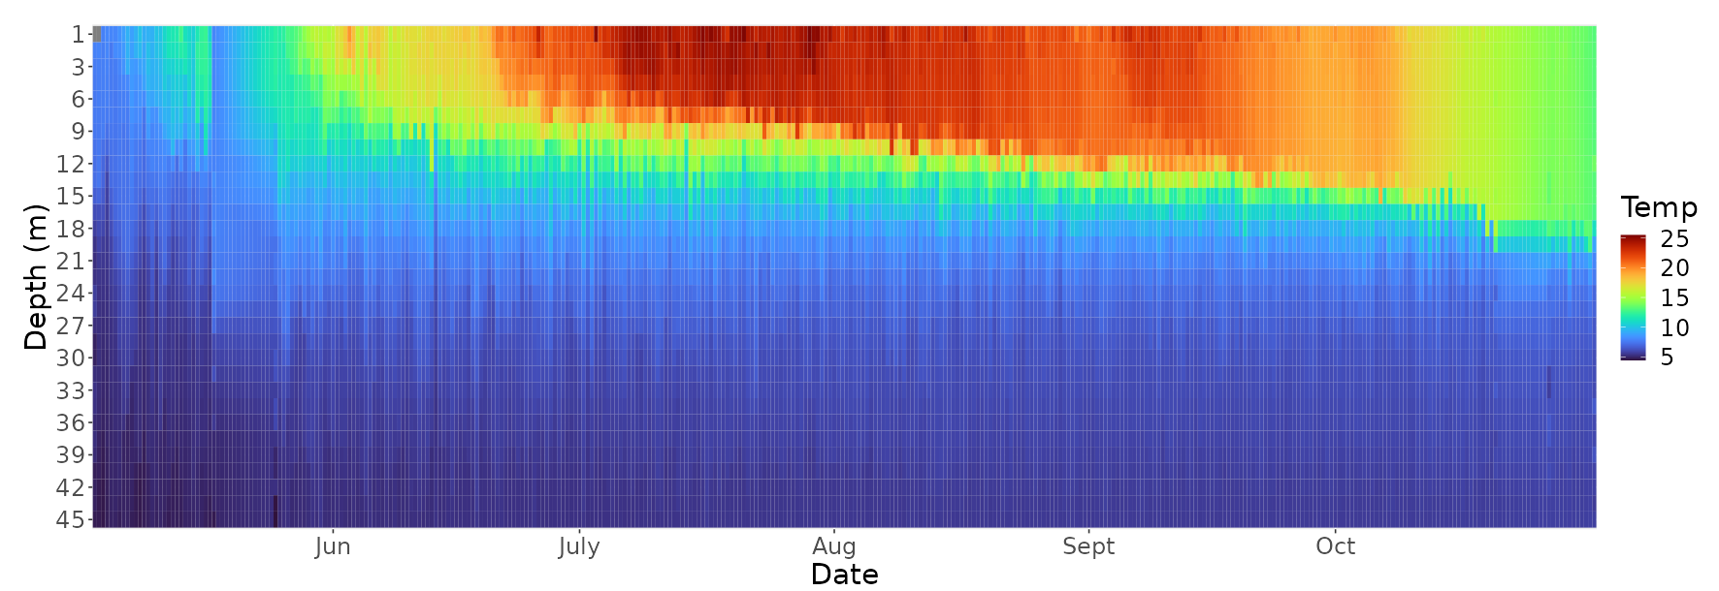
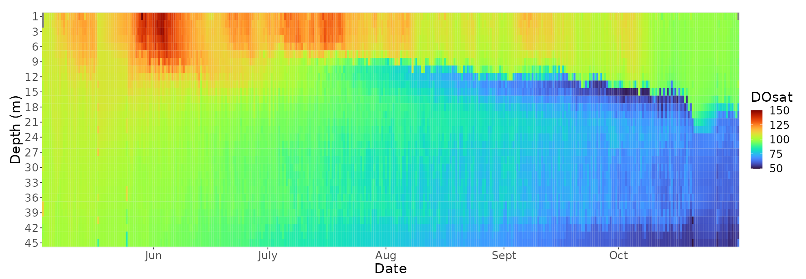
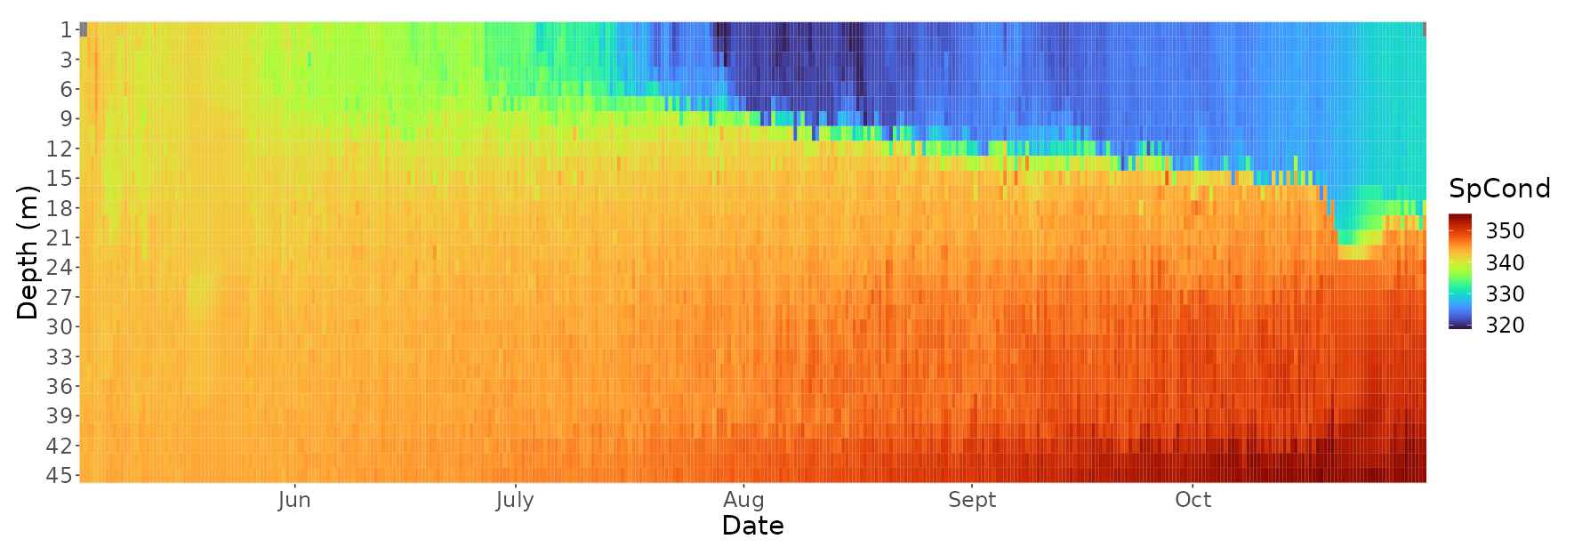
Navigating the Waves of Data: A Journey from Owasco Lake’s Buoy to Your Screen
Ben Kelley ¹, Trevor Massey, Sam-Beck Andersen, John Halfman, Lisa Cleckner
Finger Lakes Institute, Hobart and William Smith Colleges, ¹ kelley@hws.edu
Introduction
From 2014 to 2023, a continuous monitoring buoy (Fig. 2) has been deployed on Owasco Lake from late spring to late fall. Water quality data is collected at midnight and noon by raising a sonde from the bottom of the lake to the surface. Every 1.5 meters the sonde measures: temperature, salinity, turbidity, algal fluorescence, and dissolved oxygen. Meteorological data is collected every 30 minutes by averaging readings over a five minutes window.
Less frequent monitoring schedules can miss critical events: meteorological phenomena, e.g., rainfall, sustained winds, can come and go very quickly, and it is important to understand how the lake responds to these and other short-term fluxes. Additionally, long-term continuous monitoring can help to inform and evaluate management strategies. However, comprehensive analysis of the data is difficult: year-to-year adjustments to methodology, differences in deployment windows, buoy malfunctions, etc., all complicate the data collection, integrity, and consistency of the dataset.
The goal of this project is to standardize how data from continuous monitoring buoys is processed at the Finger Lakes Institute (FLI) while fulfilling FAIR (Findable, Accessible, Interoperable, Reusable) data stewardship goals that are increasingly important as data technologies continue to advance.
Fig 1: Summary of Owasco Lake / watershed characteristics and buoy location.
What is FAIR data stewardship?
Findable
Data is findable through standard search tools, like a Digital Object Identifier (DOI)
Accessible
Data is publicly accessible
Interoperable
Data is described with the appropriate metadata
Reusable
Data has clear usage license and description of provenance
Why is FAIRness important?
Academic research costs money
Money →“products” of value
We want to leverage that value for:
Publications
Accessing additional funding
Reusing methodology/code
Inter-institution comparison
If research products are not FAIR:
More difficult or impossible
Time consuming (= $$$)
Data is transferred to the FLI via a cellular data logger
R script reads and uploads raw files to DropBox
Another R script reads files from DropBox and processes data
“Tidying”
Removes irrelevant parameters
Merges respective datafiles
Dataset is passed to final R script that builds app
Fig 2: Data pipeline, representing how data goes from the physical buoy to your computer screen. Buoy photo credit: Trevor Massey
Questions…
Why do so many water quality graphs have distinct layers in the summer?
What could be causing the big jump in dissolved oxygen saturation in June?
Why does specific conductance increase at the bottom of the lake near the end of the season?
Fig 3: Temperature (°C) with Depth heatmap for Owasco Lake at the buoy site
Closing thoughts
Many research projects are funded by municipal, state, or federal grants
Owasco Buoy funding: Cayuga County, Emerson Foundation.
That means it is, in part, funded by you!
unFAIR research products have truncated longevity, utility, and impact.
Reduces potential for social good
Fig 4: Dissolved Oxygen Saturation (%) with Depth heatmap for Owasco Lake at the buoy site
Fig 5: Specific Conductivity (µS/cm) with Depth heatmap for Owasco Lake at the buoy site

